Slide 1
Human Detection in Disaster Scenarios
Karim elsayed
Malik hader
Abdulaziz Alotaibi
Hassan abouelela

Slide 2
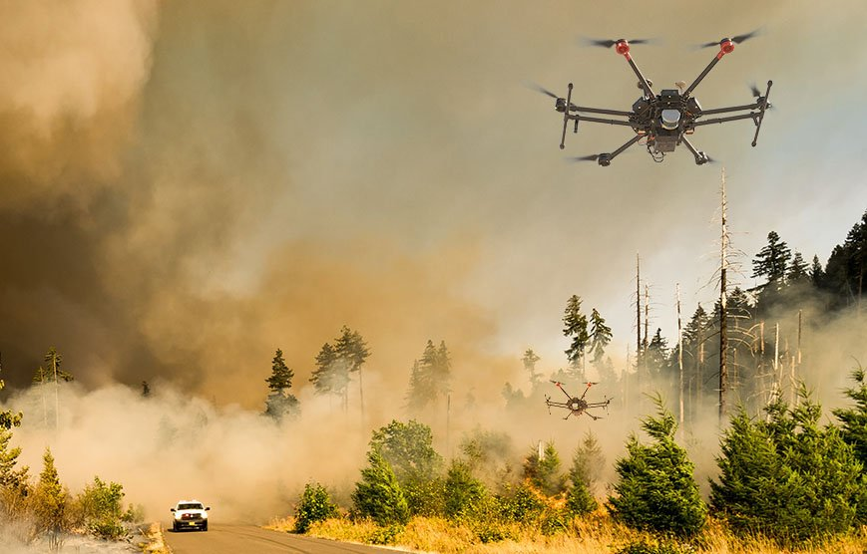
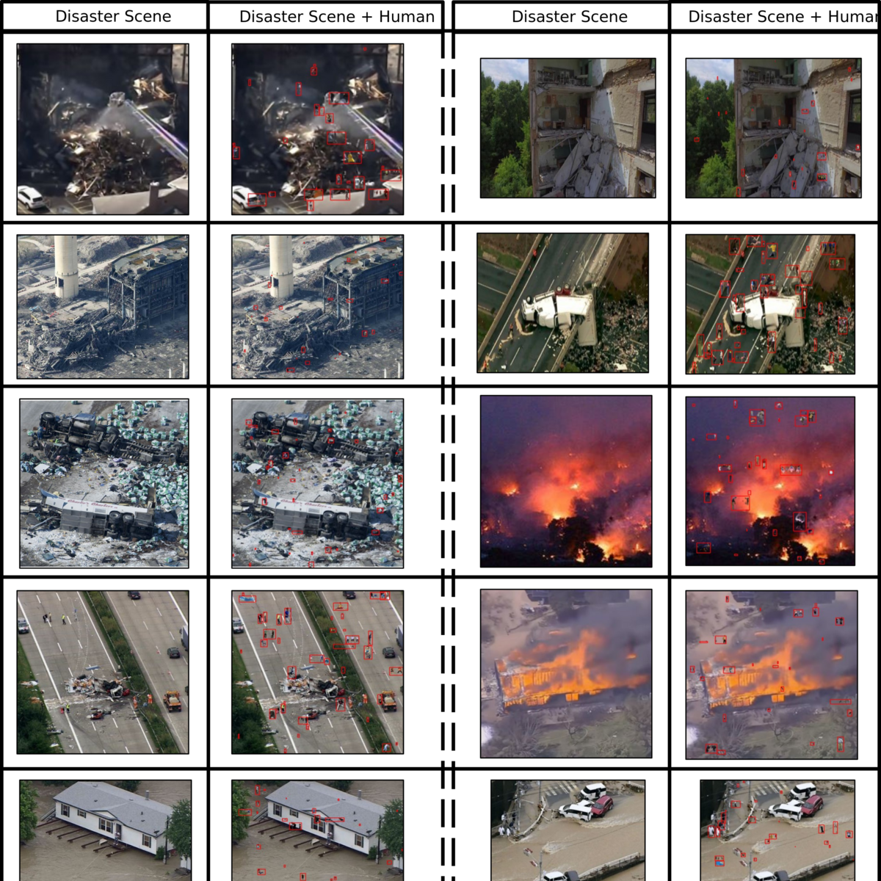
Introduction
Human detection using aerial imaging has been a research focus for years with numerous applications.
It is used to detect humans in wildlife territories where they are not permitted.
This project focuses on detecting humans in disaster scenarios (e.g., fire, earthquake, or accident).
The challenge lies in data collection
Capturing aerial images of humans from diverse environments that each present lighting, occlusion, varying resolution, and weather challenges.
Simulated scenarios (synthetic datasets) do not fully replicate real world scenarios, Ethical and privacy concerns

Slide 3
Problem Statement
The lack of effective real-time human detection systems in disaster scenarios such as earthquakes and fires delays emergency response, putting affected individuals at greater risk and hindering rescue efforts, especially in low visibility scenarios.

Slide 4
Literature Review
UAV-Enhanced Combination to Application: Comprehensive Analysis and Benchmarking of a Human Detection Dataset for Disaster Scenarios [1]
Using Deep Learning with Thermal Imaging for Human Detection in Heavy Smoke Scenarios [2]
Human Detection in Aerial Images Using Deep Learning Techniques [3]
[1] R. A. Nihal, B. Yen, K. Itoyama, and K. Nakadai, “UAV-Enhanced Combination to Application: Comprehensive Analysis and Benchmarking of a Human Detection Dataset for Disaster Scenarios,” 2024, arXiv. doi: 10.48550/ARXIV.2408.04922.
[2] P.-F. Tsai, C.-H. Liao, and S.-M. Yuan, “Using Deep Learning with Thermal Imaging for Human Detection in Heavy Smoke Scenarios,” Sensors, vol. 22, no. 14, p. 5351, Jul. 2022, doi: https://doi.org/10.3390/s22145351.
[3] S. Gundu, H. Syed, and J. Harikiran, “Human Detection in Aerial Images using Deep Learning Techniques,” 2022 2nd International Conference on Artificial Intelligence and Signal Processing (AISP), vol. abs 1612 7217, pp. 1–10, Feb. 2022, doi: https://doi.org/10.1109/aisp53593.2022.9760635.

Slide 5
Literature Review
[1]: Introduces the Combination to Application (C2A) dataset with 10,215 disaster images annotated in COCO format, featuring 360,000 human figures added using the U2-Net model. They tested various models, but YOLOv9-e achieved the best performance with mAP of 0.6883 and mAP at 50% of 0.8927).
[2]: Implemented YOLOv4 for human detection in smoky conditions using thermal imaging, and achieved precision and recall rates exceeding 98%. They combined two public datasets with images from Fluke Ti300+. Their technique can be extended to other hazardous scenarios like rubble detection.
[3]: Used HOG and Mask-RCNN for detecting humans in aerial imagery with the MS-COCO dataset, containing over 330,000 images with varying perspectives. During processing, the model employs RoIPool for feature extraction from bounding boxes, and a SoftMax classifier for human detection among various objects. Mask-RCNN achieved mAP of 95%, outperforming R-CNN and Fast R-CNN, and offering real-time detection speed of 0.026 seconds perimage.

Slide 6
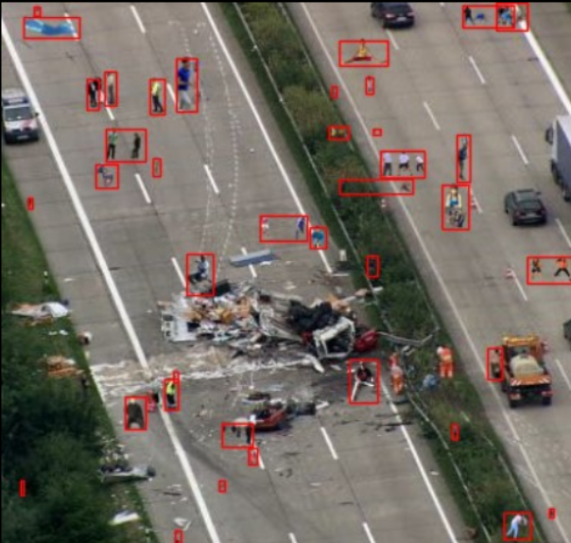
Methodology
Dataset: "C2A: Combination to Application Dataset:", which is a synthetic dataset of UAV imagery for human detection.
Consisting of 10,215 images with both YOLO and COCO Labels, containing over 360,000 annotated human instances.
Data Indigestion: resizing images to 640x640 to fit YOLO expected input dimension
YOLO: using the Ultralytics module.
Deep learning models: YOLOv8n – YOLO11n – YOLO11s
Performance metrics for evaluation: Precision – Recall – mAP50 – mAP50-95

Slide 7
Implementation
First, we start by importing the Ultralytics module, then using the YOLO class
Second, we create a data.yaml file that includes the paths of the training, testing and validation dataset.
Third, we specify the YOLO version.
Fourth, we specify the hyperparameters
-> Batch size = 16
-> epochs = 50
-> Optimizer: Adam
-> DFL_loss & box_loss were used for the loss function
Results are saved on a directory specified by us, the directory contains information on every epoch, necessary for us to evaluate the model.

Slide 8
Results
No pose estimation:-
 | Precision | Recall | mAP50 | mAP50-95
YOLOv8n | 0.829 | 0.701 | 0.763 | 0.488
YOLO11s | 0.858 | 0.728 | 0.80 | 0.548
Pose estimation:-
 | Percision | Recall | mAP50 | mAP50-95
YOLO11s | 0.182 | 0.642 | 0.183 | 0.118

Slide 9
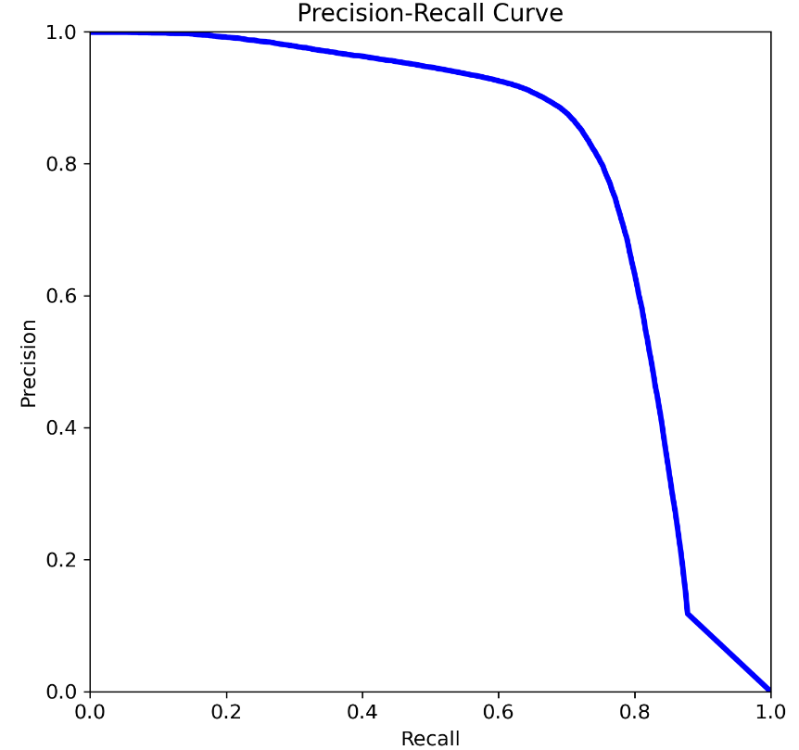
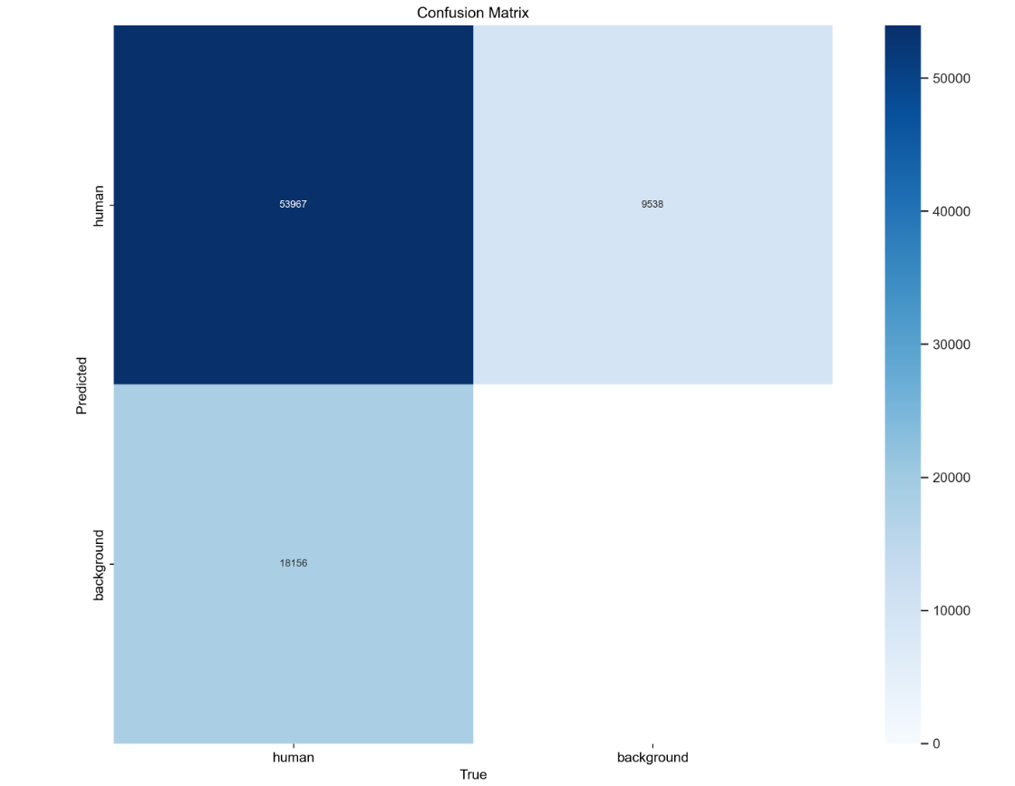
Results (best model)

Slide 10
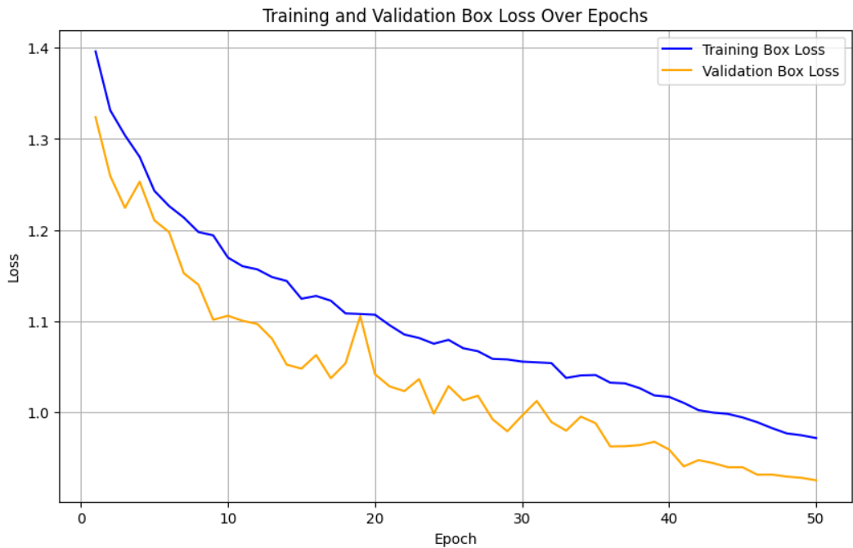
Performance evaluation

Slide 11
Discussion
We found out the pose estimation is not as good as expected. This is due to the fact that poses are not easy to differentiate in the dataset due to aerial imagery.
YOLOv11, even though we used the small variant of the model, our results tend to be the second highest in literature, with small computational power.

Slide 12
Work Division
Karim Elsayed: Yolo V11-s pose estimation fine-tuning, Literature Review
Malik Hader: Yolo v11 fine-tuning with standard labels, Literature Review
Abdulaziz Alotaibi : Yolo v8 standard labels, Transformer Architecture Literature Review
Hassan Abouelela: README, similar Works and small object detection Literature Review.

Slide 13
Demonstration
Now we will show you a live demo of our notebook.

